Slide 1
ROLANDO TINOCO OJANGUREN
NOVIEMBRE 1962 / ENERO 2023

Slide 2
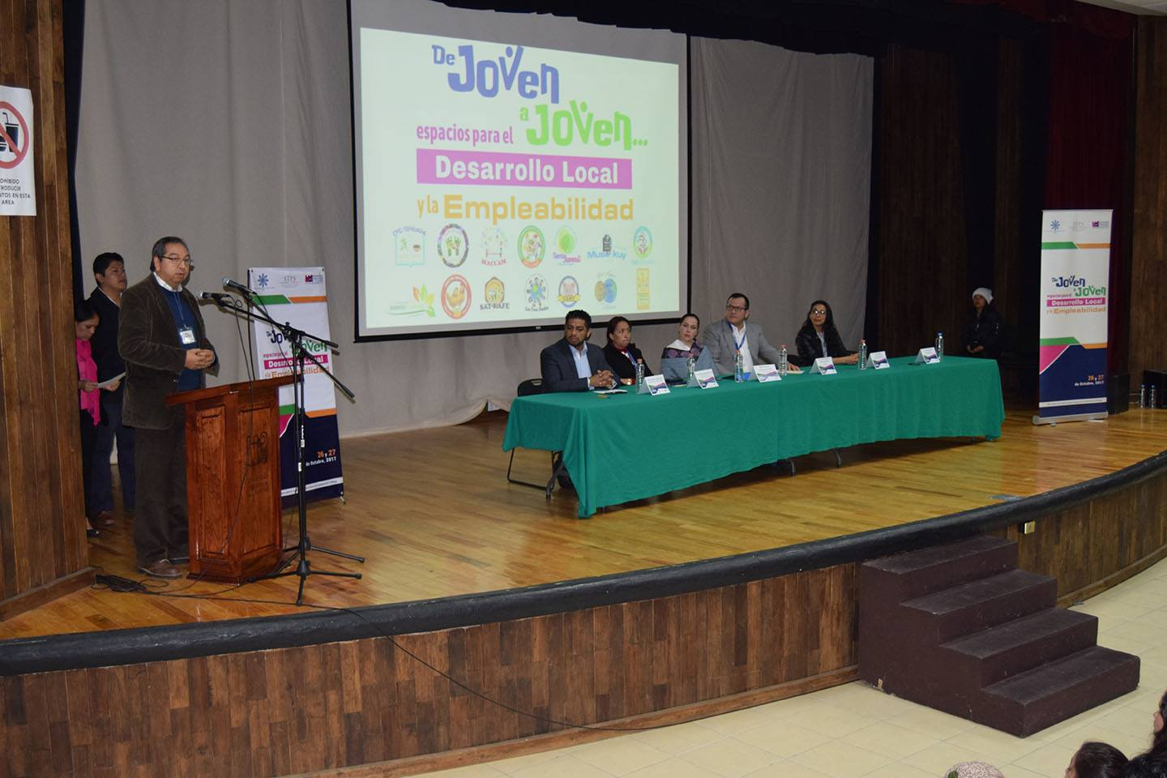

Slide 3
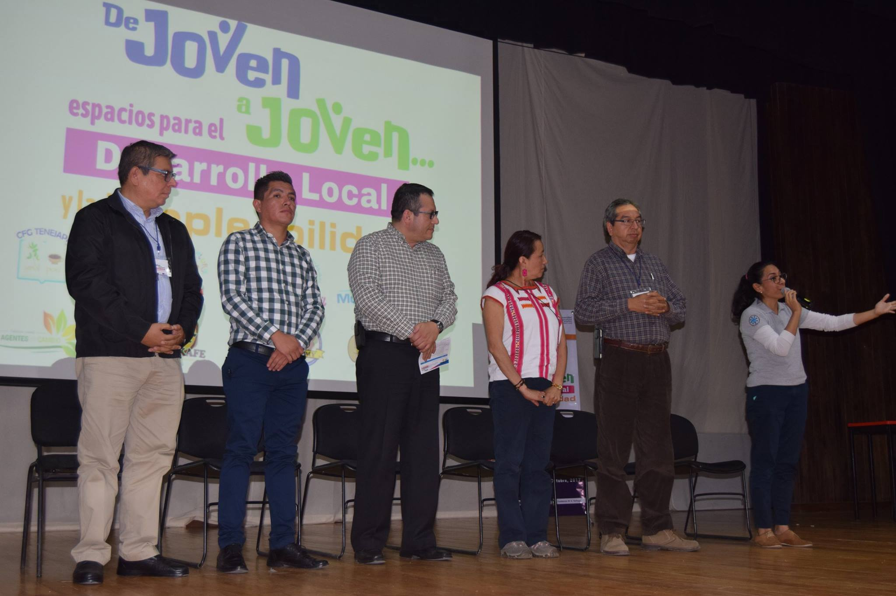
Mission statement
You can describe here the company’s mission. A clear message is a good way to get down to business

Slide 4
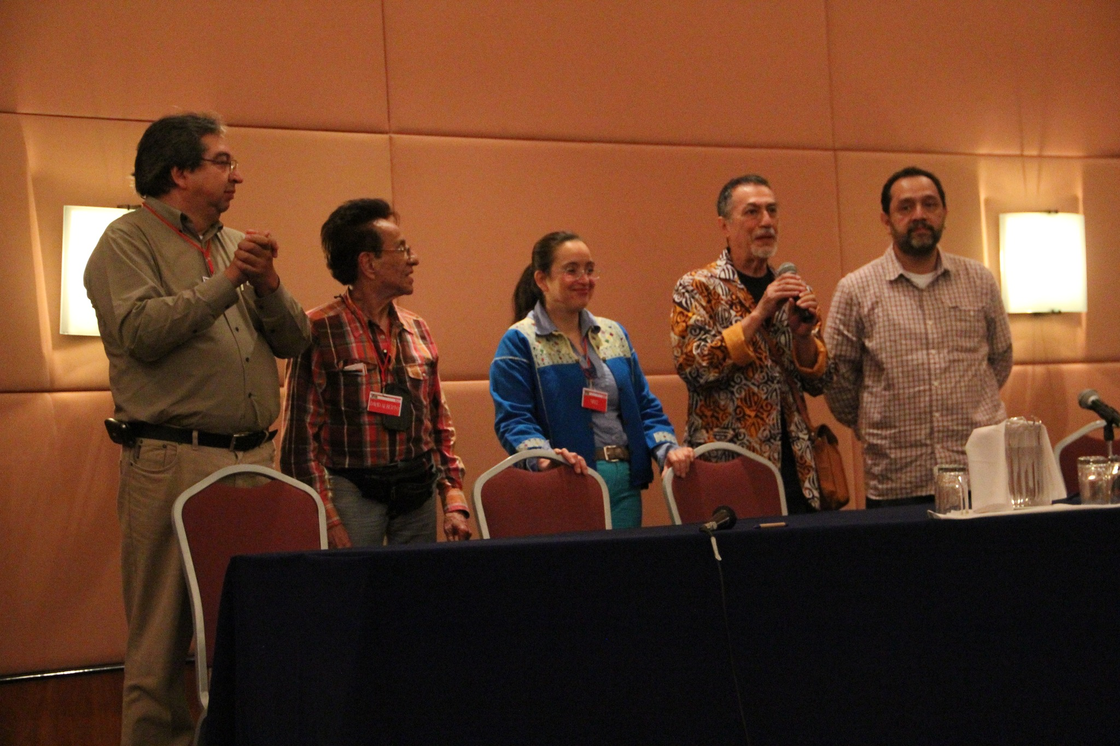

Slide 5
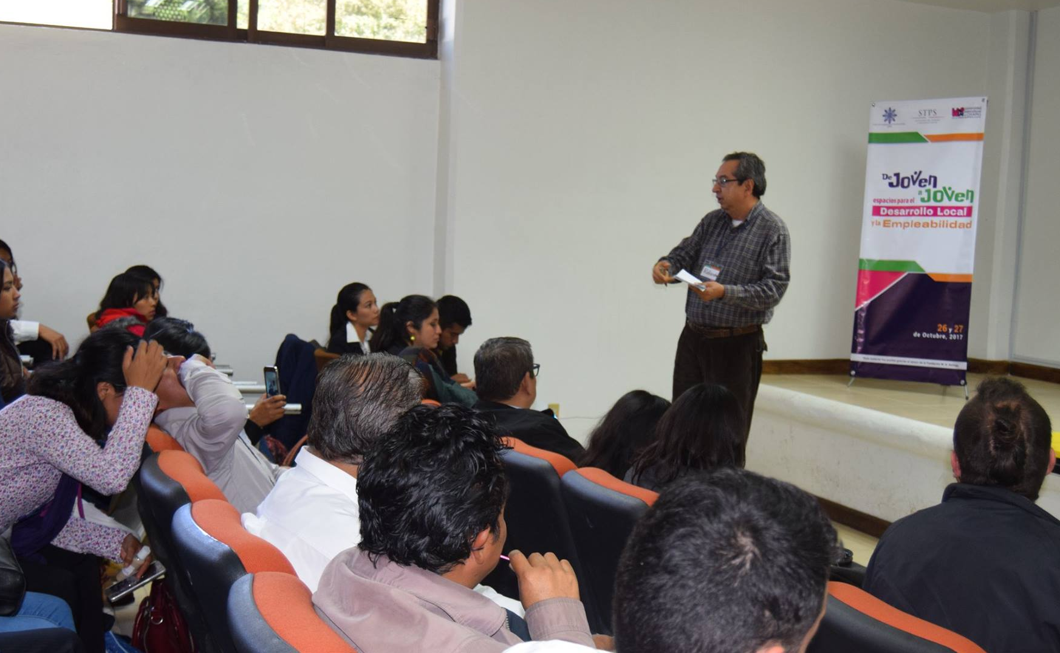
Our company
Do you know what helps you make your point clear?
Lists like this one:
They’re simple
You can organize your ideas clearly
You’ll never forget to buy milk!
And the most important thing: the audience won’t miss the point of your presentation

Slide 6
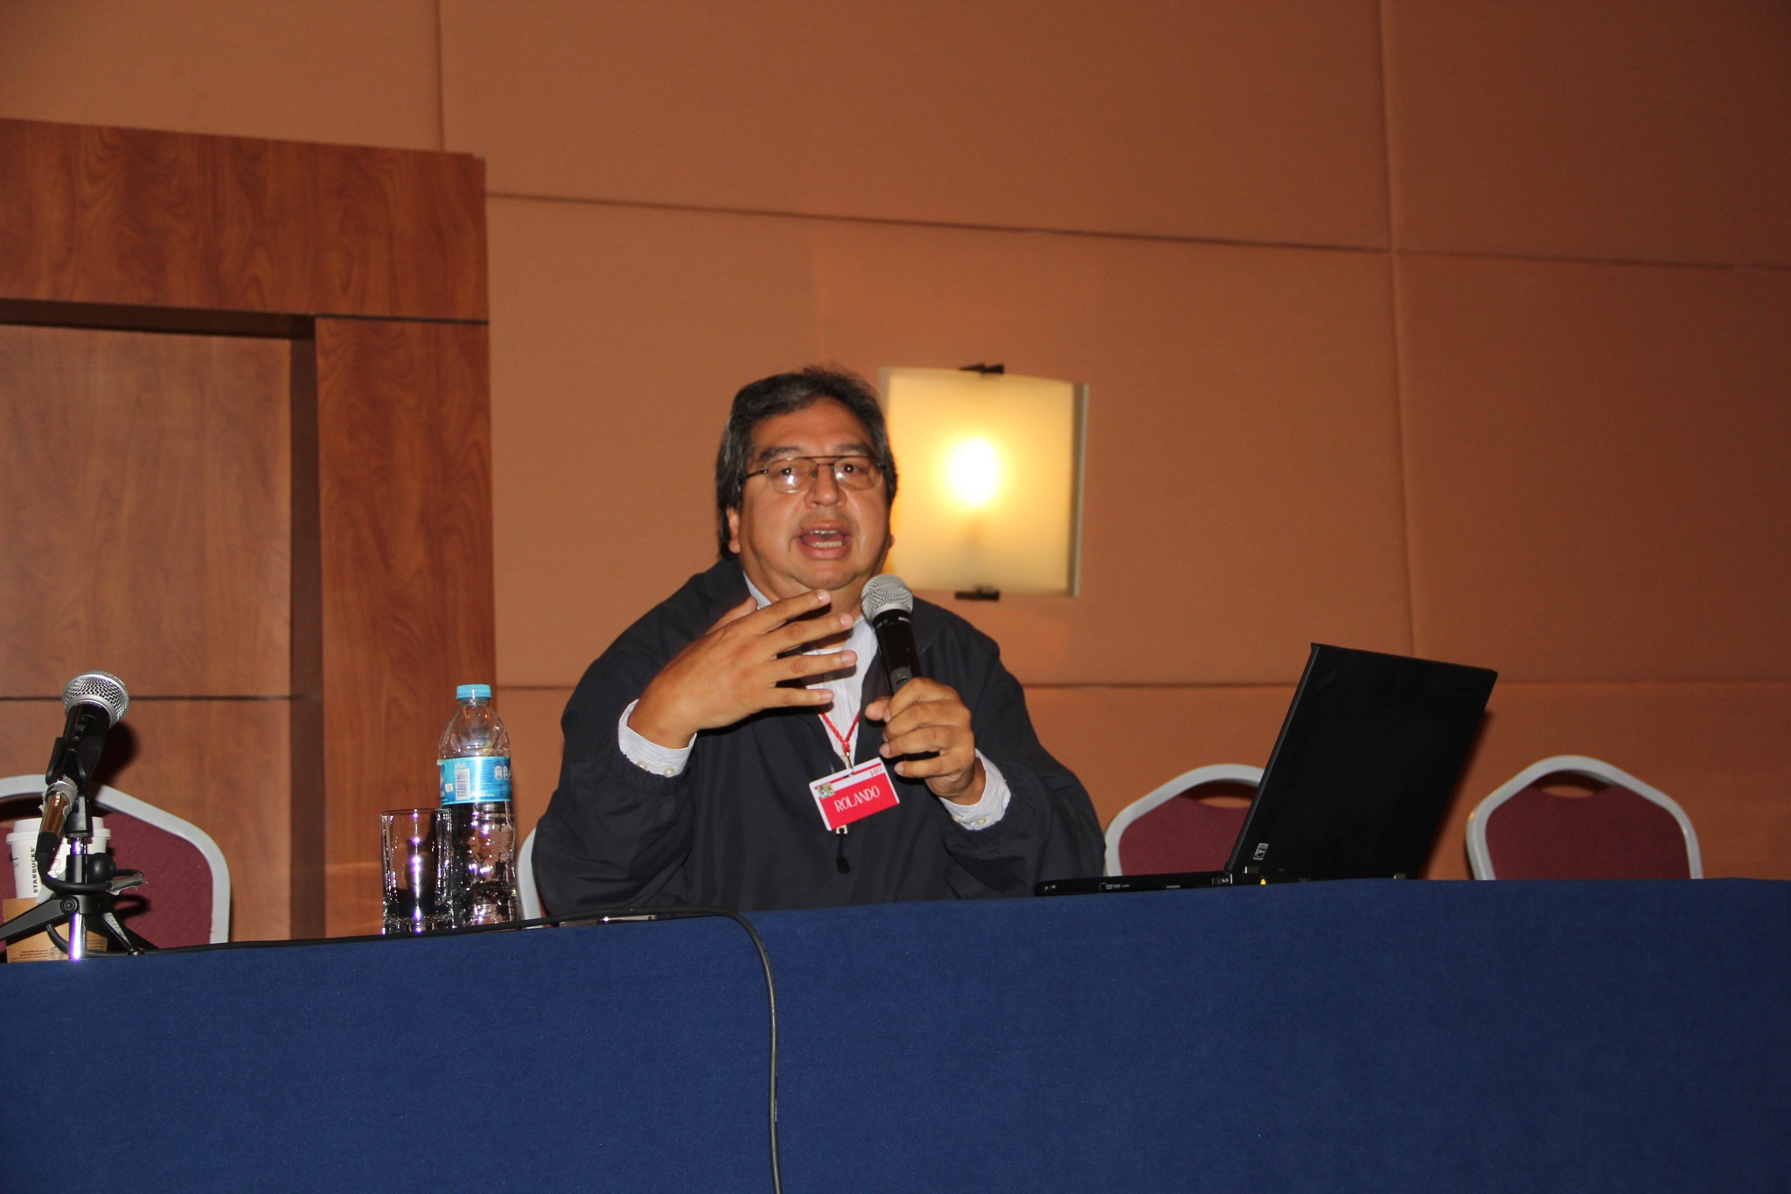

Slide 8
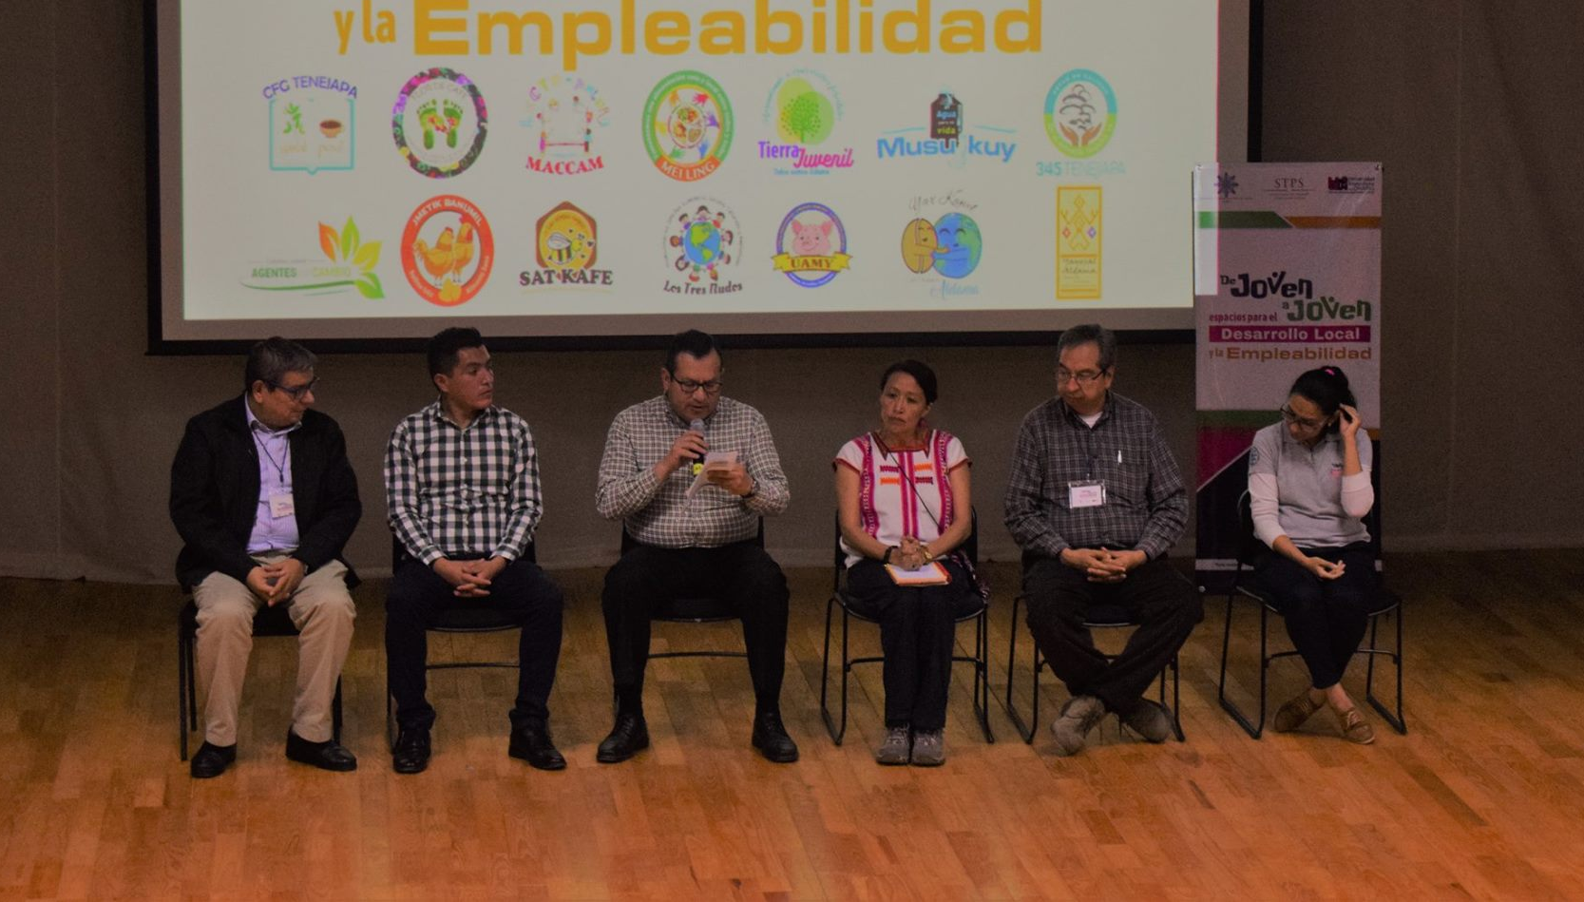

Slide 9
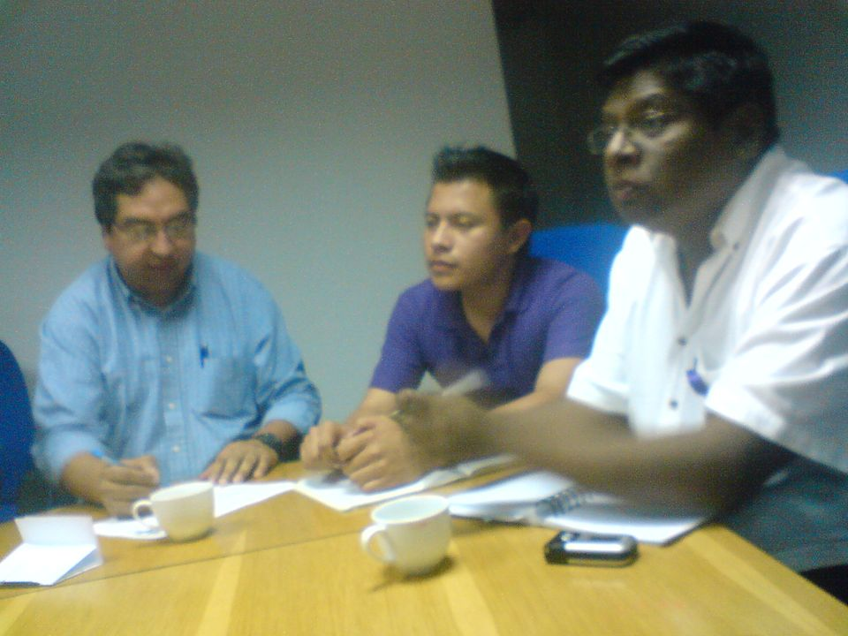

Slide 10
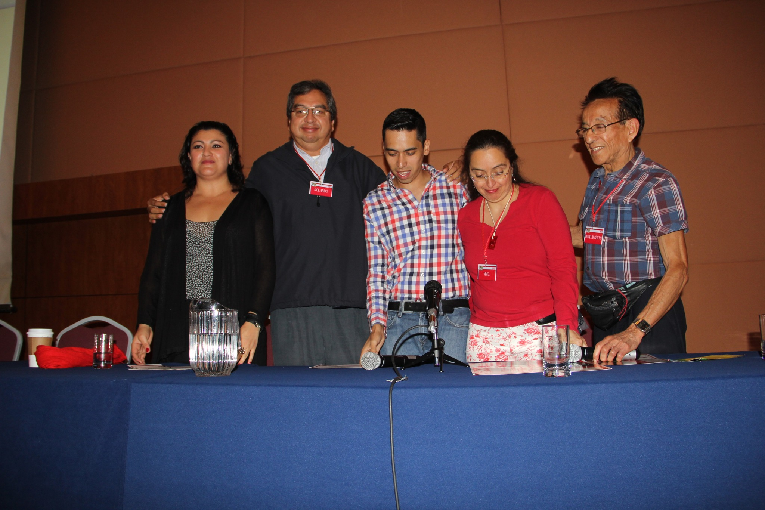

Slide 11
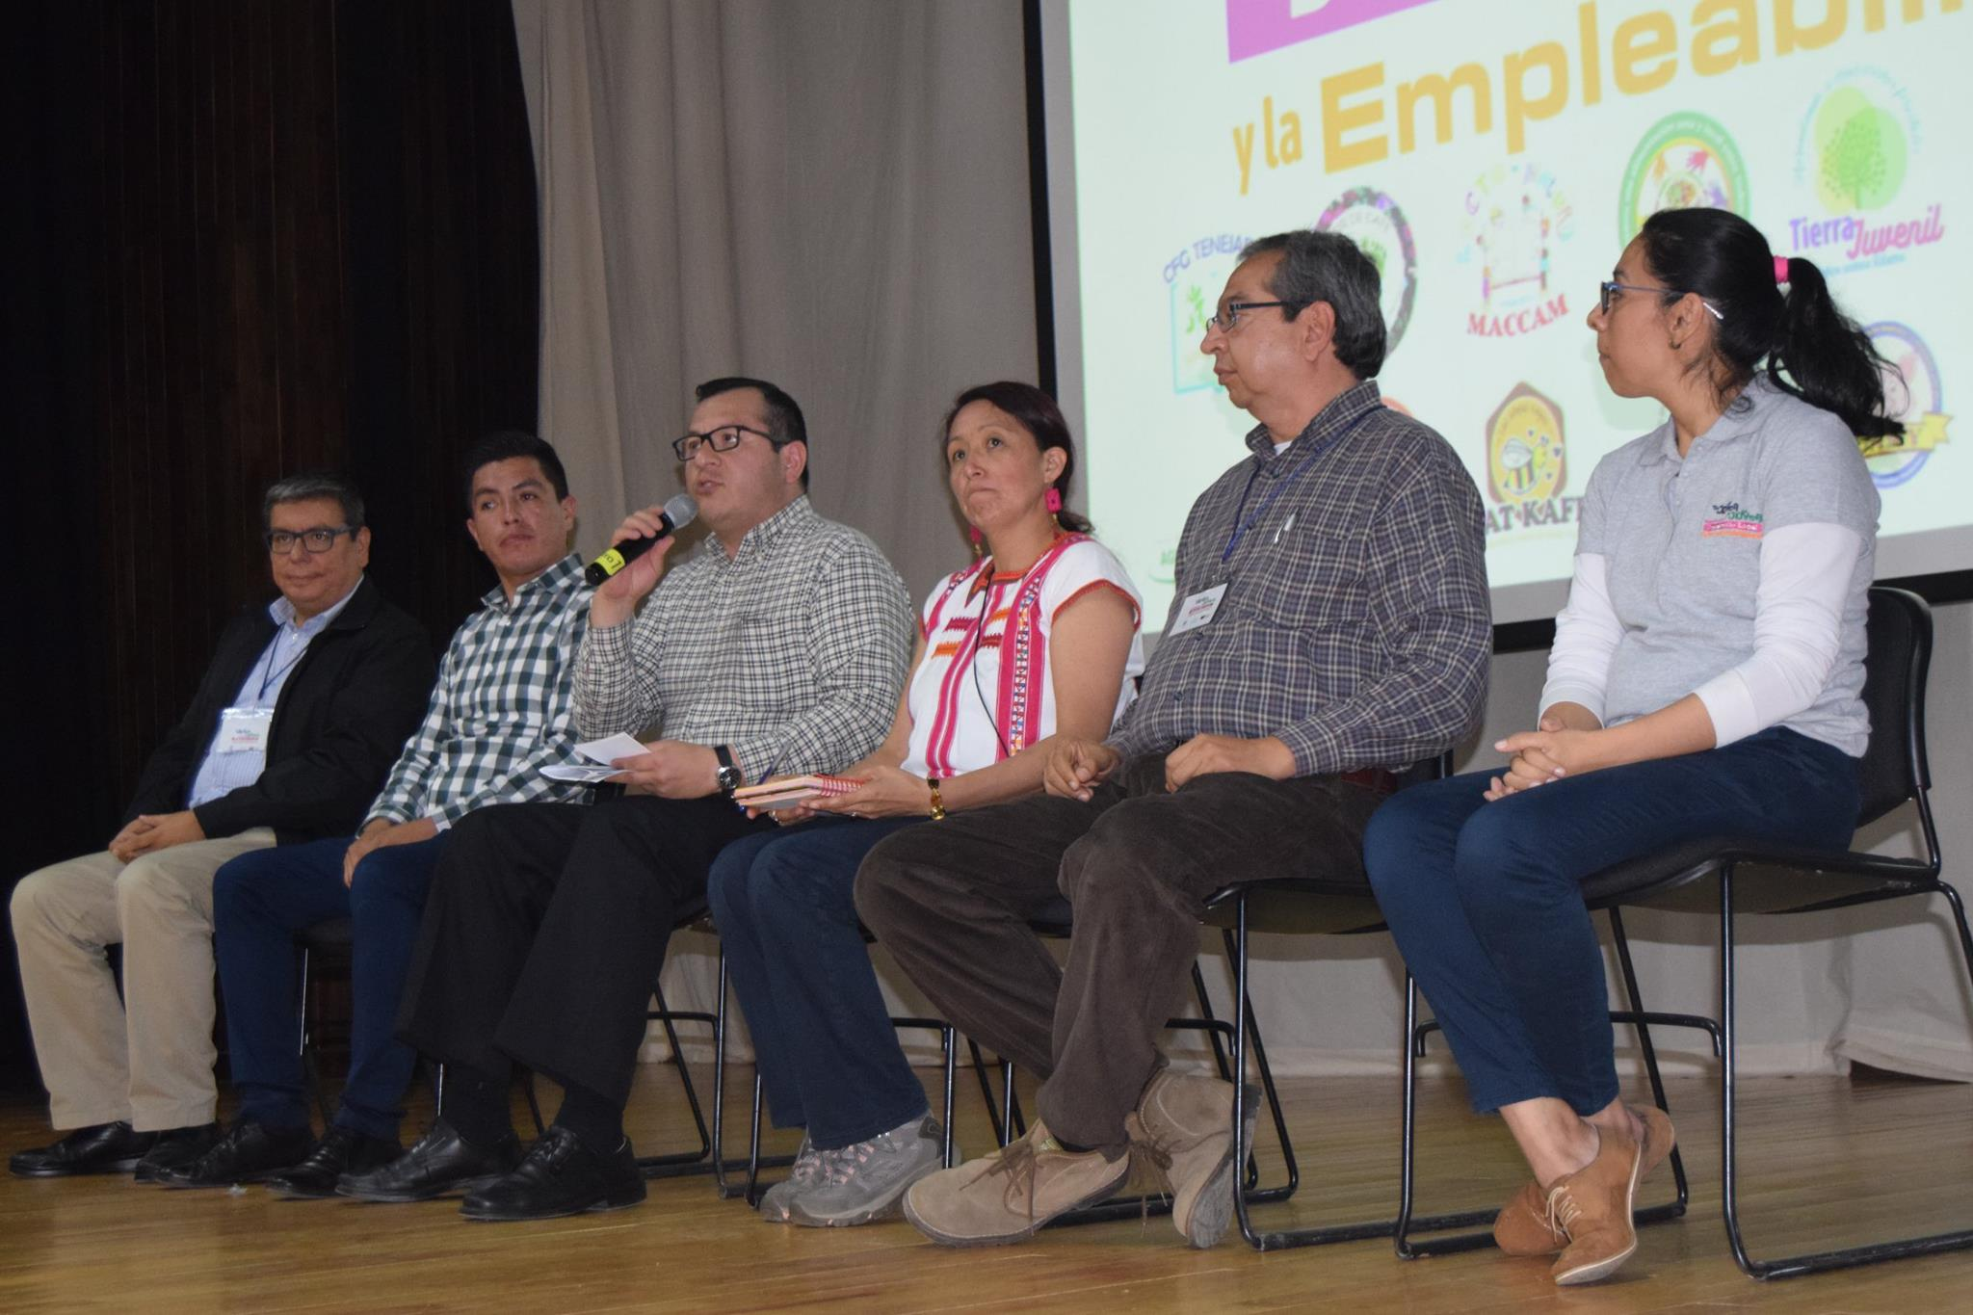

Slide 13
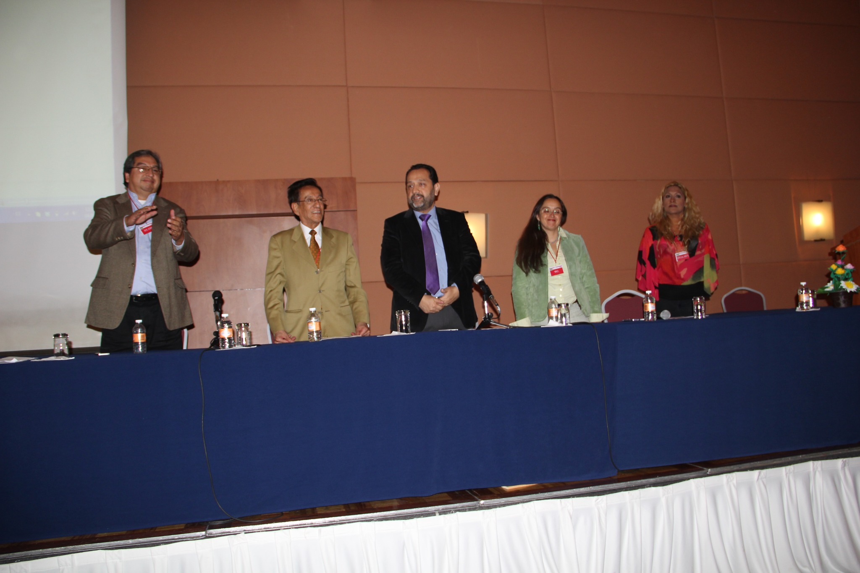

Slide 14
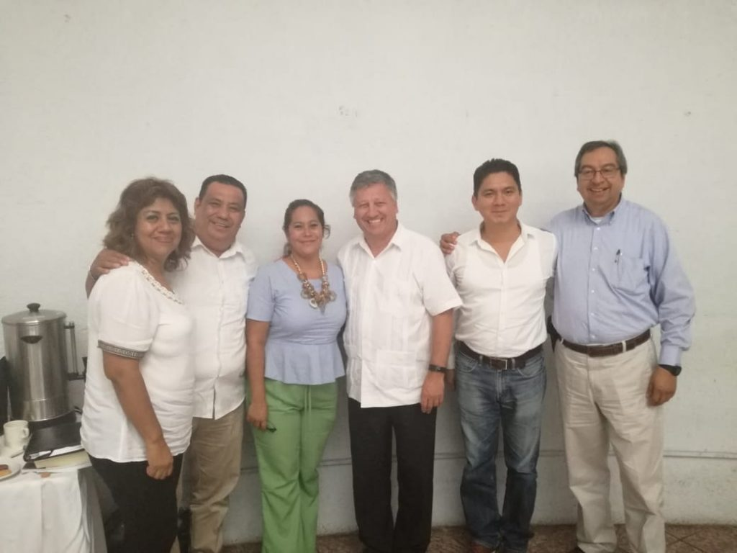

Slide 15
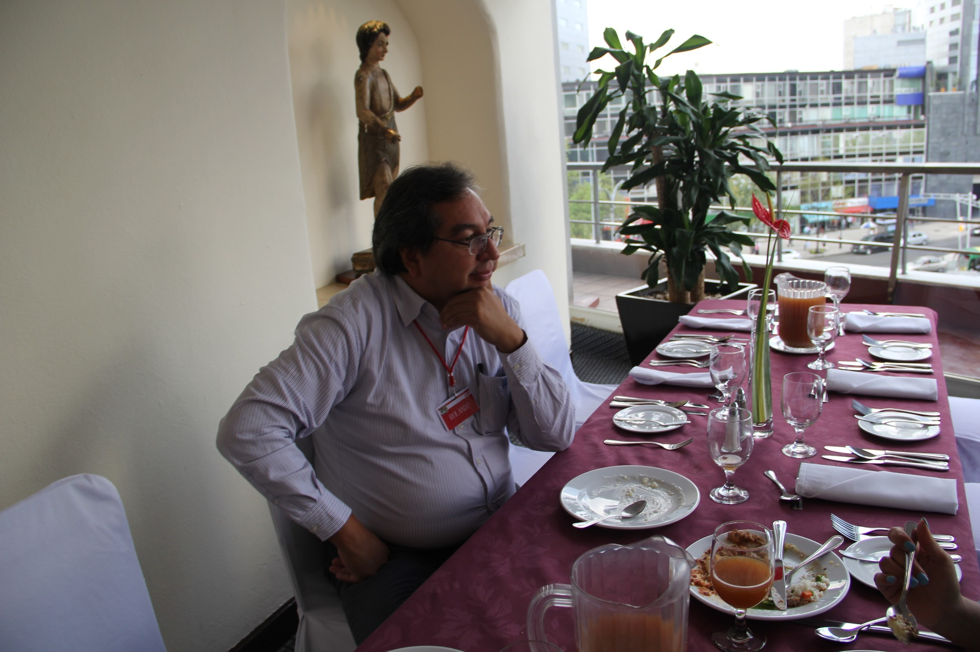

Slide 16
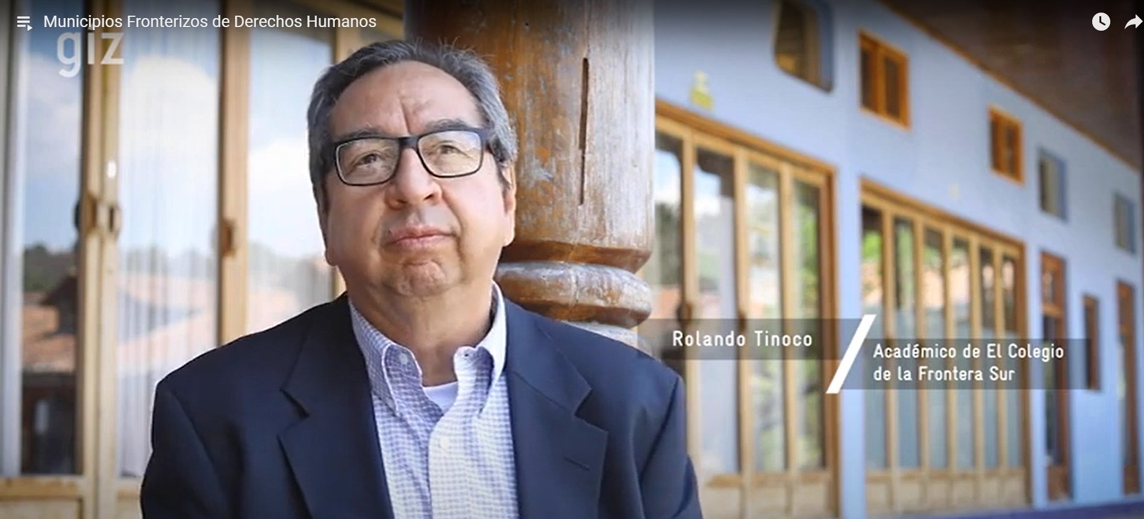
06.
Financial plan

Slide 17
DESCANSA EN PAZ AMIGO ROLANDO

